Slide 1


Token Project
Isaacs Adeyemo, Georgino Issak, Brennan Peters

Slide 2

What is Uniswap?
Decentralized Exchange
Cryptocurrency (UNI)
Background
Open Source
Proof of Stake (POS)
Founders
What makes it unique?
Notes:
- Uniswap is a decentralized exchange that enables peer to peer market making, meaning that transactions can be made between 2 parties without the need for an intermediary, like a bank for example. These parties can offer liquidity to the market.
- Uniswap is also a cryptocurrency platform with the symbol UNI
- The Uniswap blockchain is hosted on the Ethereum platform, specifically as an ERC-20 Token and is governed by UNI token holders, meaning it is a public good.
- The Uniswap blockchain is also open source, meaning anyone can view and contribute to the blockchains code
- Uniswap currently uses the proof of stake operating system since 2022 from using the Proof of Work method.
- POW: First to solve puzzle gets to add blockchain
- POS: Like a raffle where more tokens they hold the higher chance they can validate a new block
- Uniswap was first released in 2018 by its founder Hayden Adams. In 2020, Uniswap v2 launched allowing direct swaps between basically any ERC 20 token
- What’s unique or interested about the Uniswap Protocol, is that it doesn’t actually receive any revenue. The primary design of Uniswap is to incetivize liquidity providers, and so the fees largely go to them. But its important to separate the Uniswap protocol and Uniswap labs, the team behind the protocols development. Uniswap Labs can have multiple revenue streams such as grants, sponsorships, etc. UNI holders who hold more than 1% of the total supply can submit development proposals, while any uni holder regardless of how much they hold is able to vote on these proposals. It’s designed to be this way in an effort to make it a truly self sustaining and decentralized protocol in the future.

Slide 3
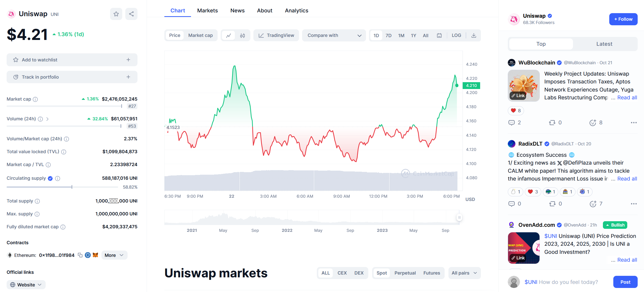
Uniswap - Today
Notes:
- It’s a fairly big project now, they’ve amassed 70,000 followers on twitter, with a market cap of 2.5 billion dollars.
- The Uniswap Ecosystem is thriving, its known to be a significant player in the DeFi sector
- Uniswap is also in a transition phase with the introduction of UniswapX which launched on July 17, 2023 and the ongoing development of Uniswap v4 which was announced on June 13, 2023
- Right now Uniswap V4 is in an almost alpha stage, a preliminary version of the Uniswap v4 code has been released for community evaluation, showcasing new features like hooks or plugins that aid developers in building personalized liquidity pools​

Slide 4
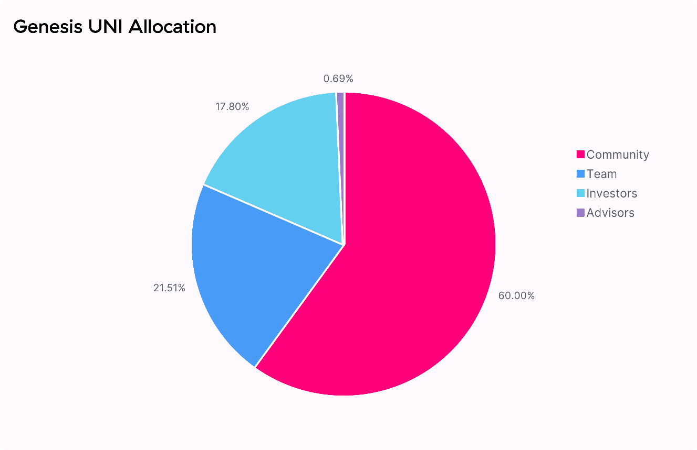
The Uniswap Protocol token: UNI
Went live Sept. 15, 2020 by airdrop to its current users
Community-led Governance token
If a user holds >1% they can submit development proposals that everyone can vote on
Contact address: 0x1f9840a85d5aF5bf1D1762F925BDADdC4201F984

Slide 5
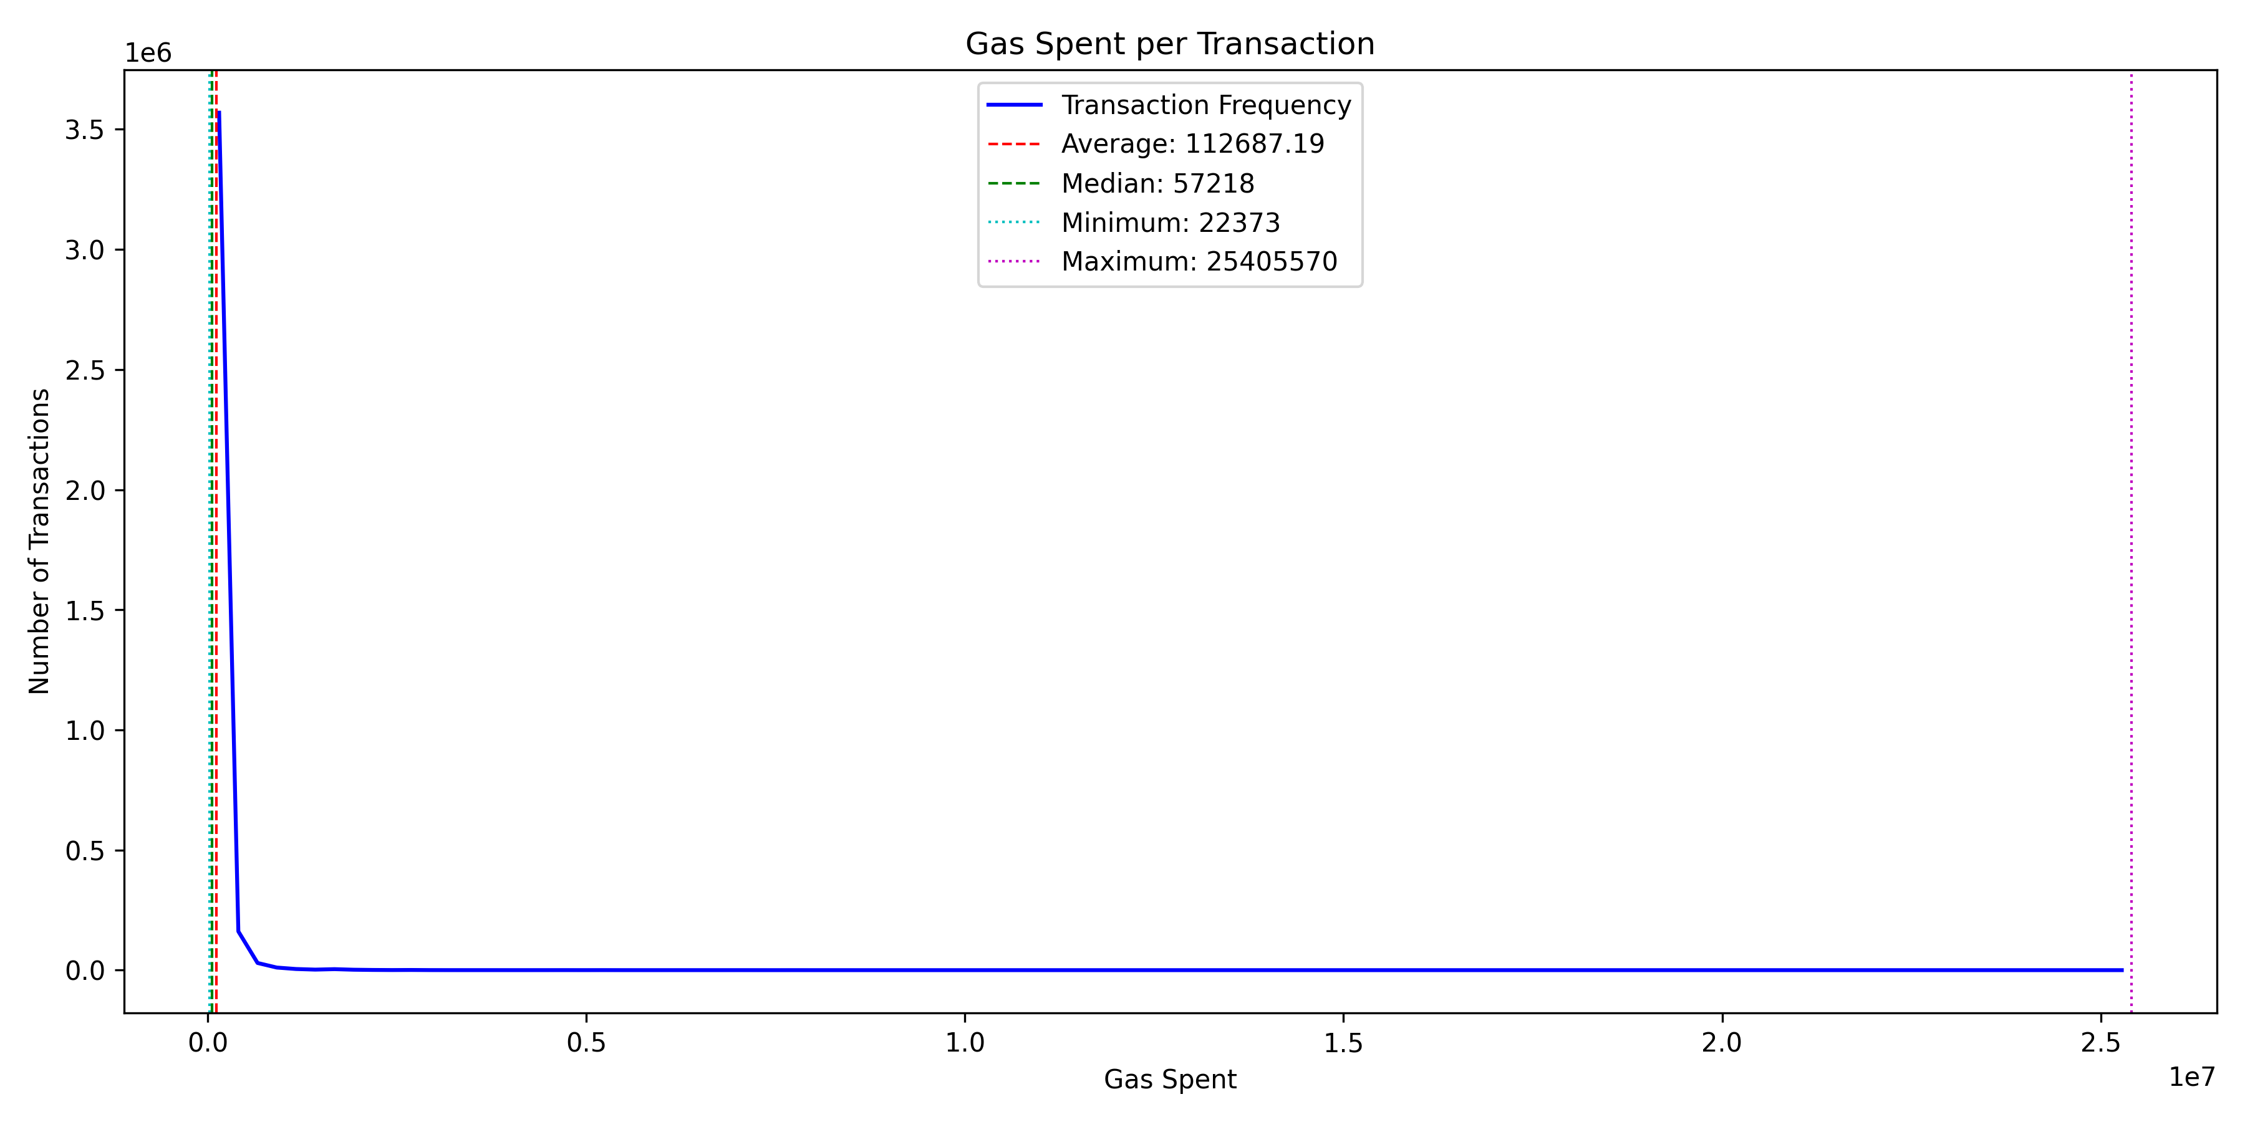
General Stats – Gas Spent / Transaction
Notes:
Now we’ll move into some General Statistics such as Gas Spent per transaction.
The minimum is about 22000 and the maximum is 25 million, which shows the different use cases for the UNI token, ranging from simple to complex natures.
As we can see, There is a steep decline of the blue line near the y-axis. This suggests that most transactions are of a relatively simple nature, needing minimal gas and minimal computational resources. This might include basic transfers or swaps.
The high maximum value can indicate that there are some complex interactions or activities related to the UNI token that consume a significant amount of gas. This could involve smart contract interactions or large-scale operations.
The fact that the average is higher than the median can indicate that although most transactions are relatively low in gas cost, there are enough high-gas transactions to skew the average upwards.
Considering that most transactions do not seem to take a high amount of computational resources, it could mean that most users perform only basic token transfers.

Slide 6
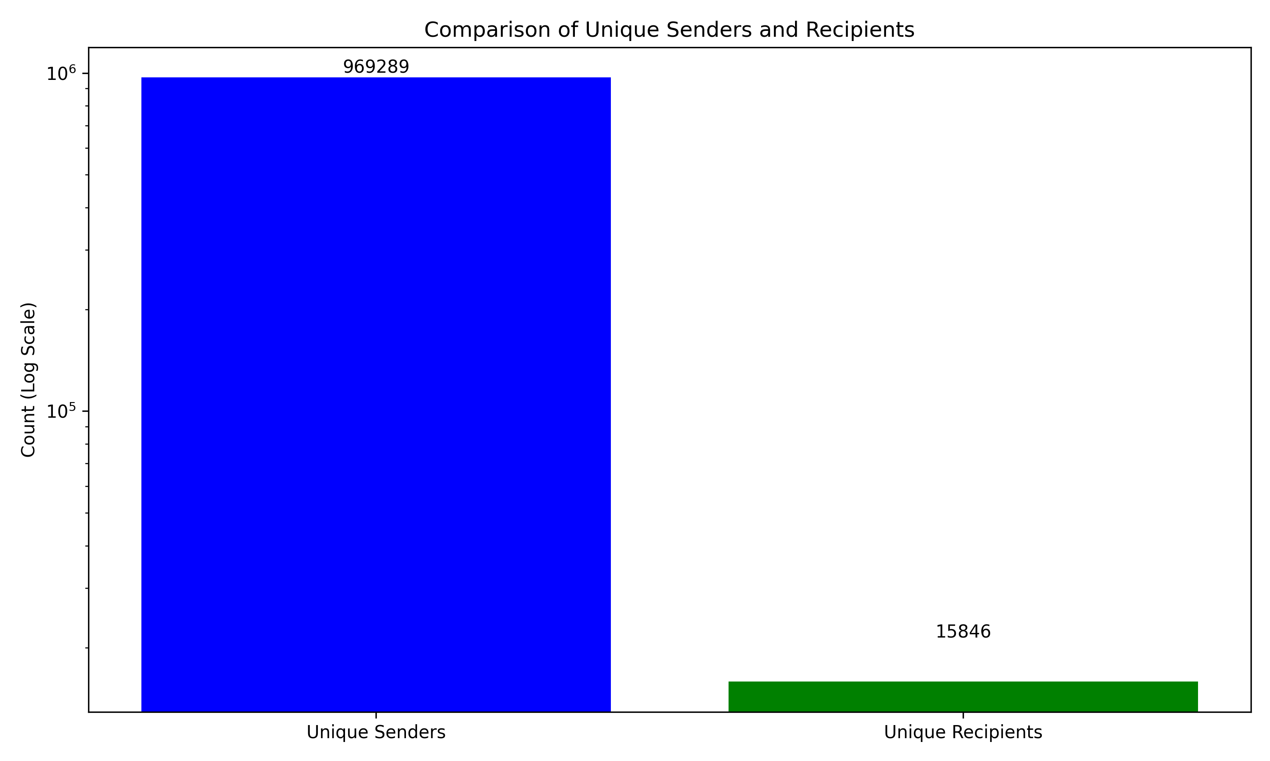
General Stats – Unique Senders/Recipients
Notes:
Next we’ll look into the Unique Senders vs Unique Recipients. The fact that there's a high number of unique senders suggests that the UNI token is popular among people in the community.
The major contrast in the number of senders compared to recipients might be because of a smaller number of addresses (like exchanges or major holders) are receiving the majority of the UNI token transactions.
This is especially concerning because it raises centralization concerns if a small number of recipients hold the majority of UNI tokens and it’s crucial for assets in decentralized networks to be distributed among a great number of people in order to avoid influence and really be decentralized.

Slide 7
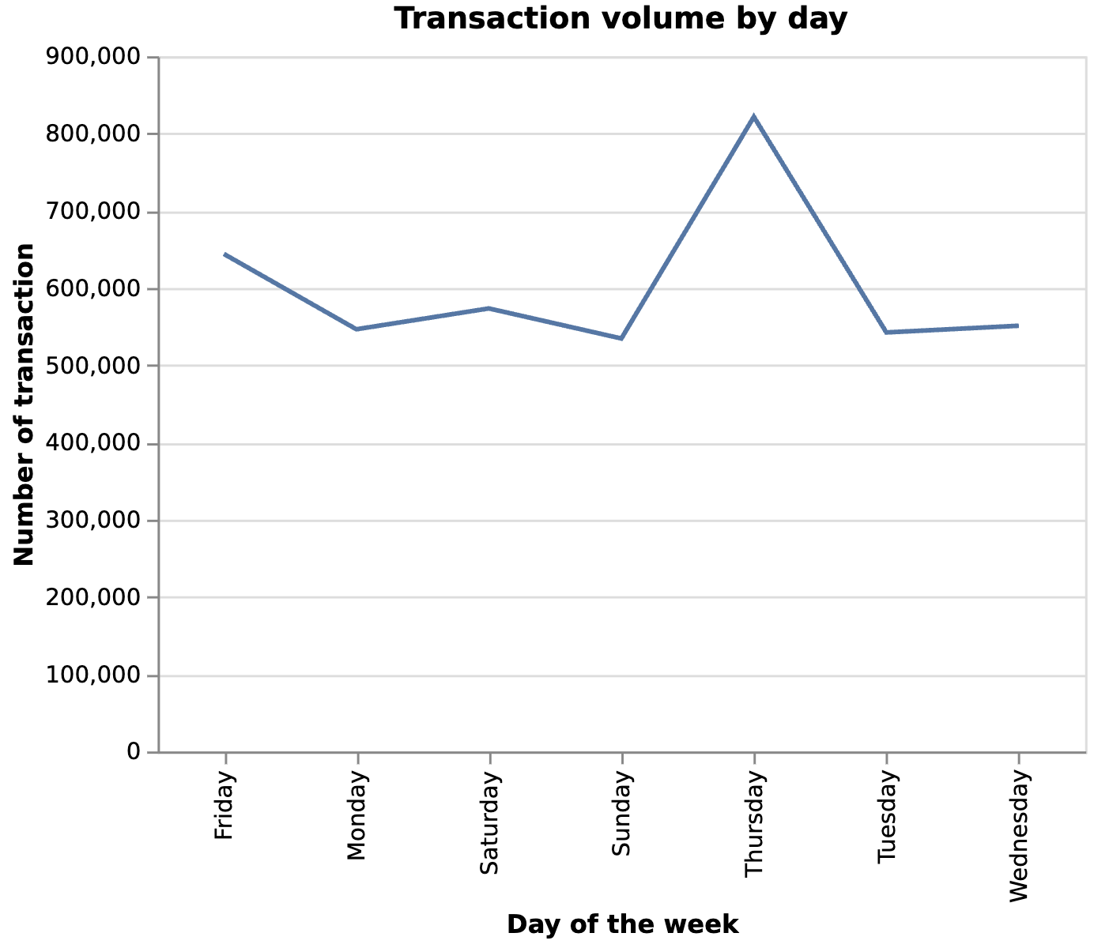
Volume by Day of Week
UNI launched on a Thursday

Slide 8
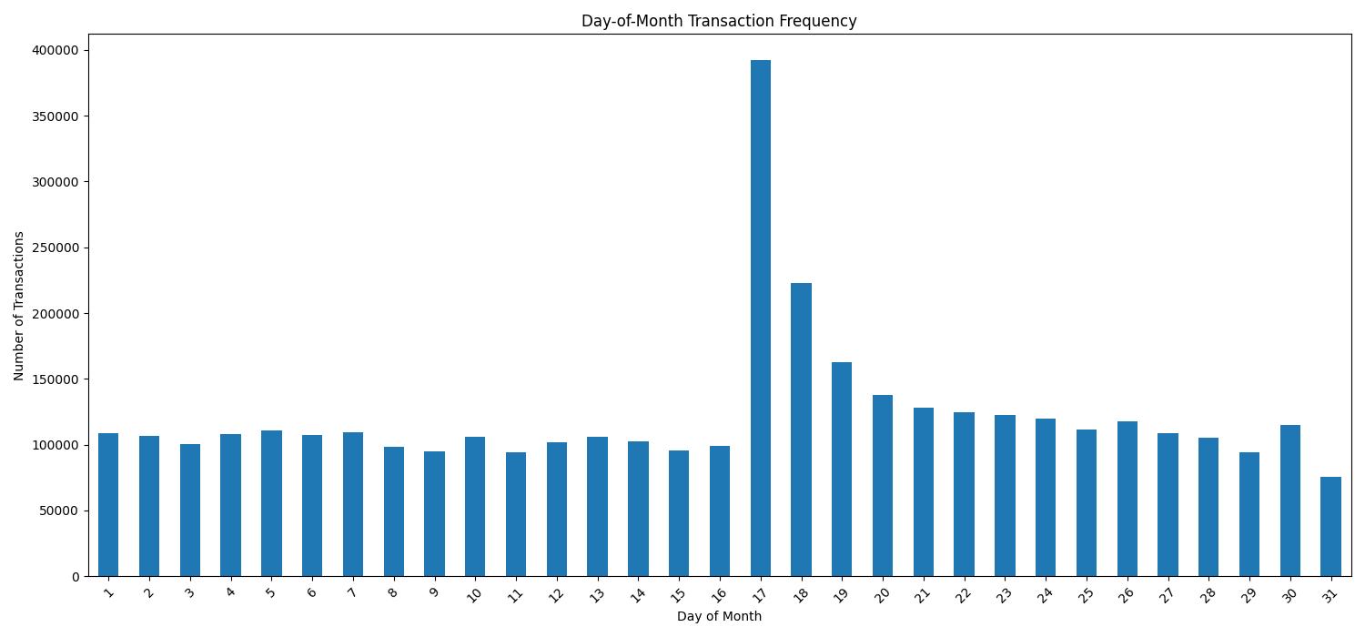
General Stats – Day of Month Transactions
Notes:
Now we’ll look into the Day of Month Transaction Frequency
For most of the month, the number of transactions seems relatively uniform, they only fluctuate a bit, which can mean there are routine transactions occurring every day. But the 17th is a notable exception.
Some reasons for this exception could be a payment or billing cycle or things of that nature.

Slide 9
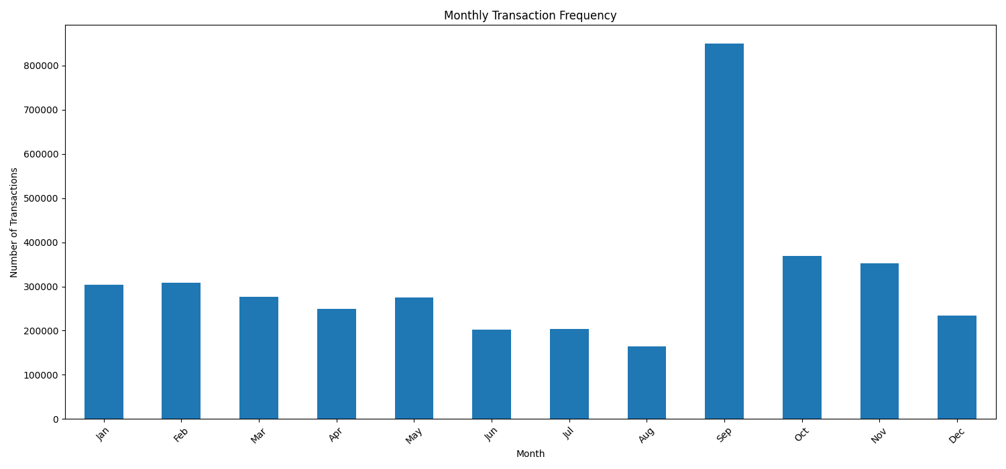
General Stats – Monthly Transactions
Notes:
Now we’ll look into the Monthly Transaction Frequency
For most of the year, once again, the number of transactions seems relatively uniform, they only fluctuate a bit, which can mean there are routine transactions occurring every month. But September is a notable exception.
Some reasons for this exception could be due to the fact that the initial release for the UNI token was in September 2020, when it initially released it was in the top 40 cryptocurrencies by market capitalization (https://bravenewcoin.com/insights/uniswap-price-analysis-bullish-technicals#:~:text=Uniswap%20released%20a%20governance%20token,BraveNewCoin%E2%80%99s%20market%20cap%20table%2C%20with), in fact its monthly trade volume for that month exceeded Coinbases’ (https://finance.yahoo.com/news/uniswap-monthly-trade-volume-exceeded-164350546.html#:~:text=During%20September%2C%20Uniswap%20saw%20approximately,6). which could be influencing the results.

Slide 10
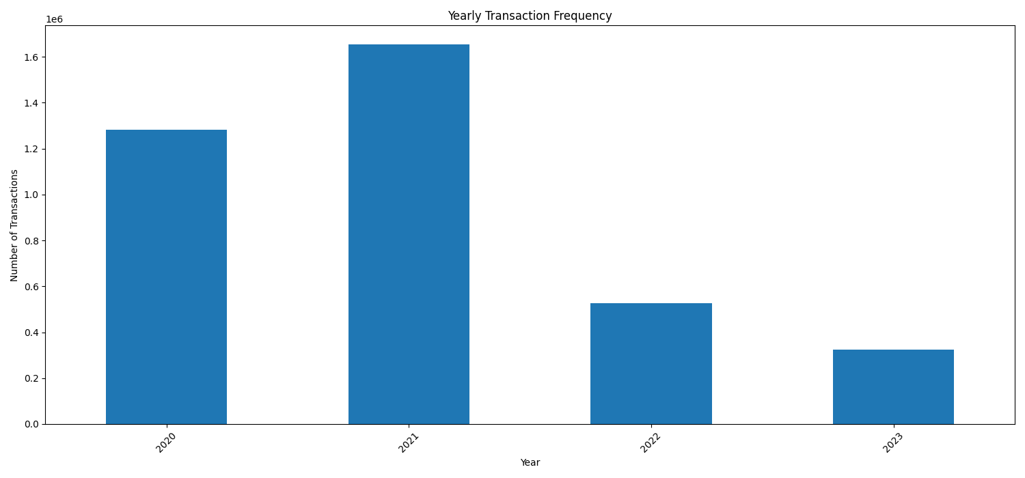
General Stats – Yearly Transactions
Notes:
Now we’ll look into the Yearly Transaction Frequency
2020: When UNI initially launched, this could explain the spike
2021: The highest number of transactions, nearing 1.6 million. This was when the Crypto scene was gaining traction and there was a lot of hype. 2021 is also when Uniswap V3 released and issued NFTs to users. As well as other important news like Optimism Layer Integration, and a governance proposal with a budget of 1 million UNI.
And a decrease from there, it could be because of market saturation, lack of updates, regulatory concerns, etc.

Slide 11
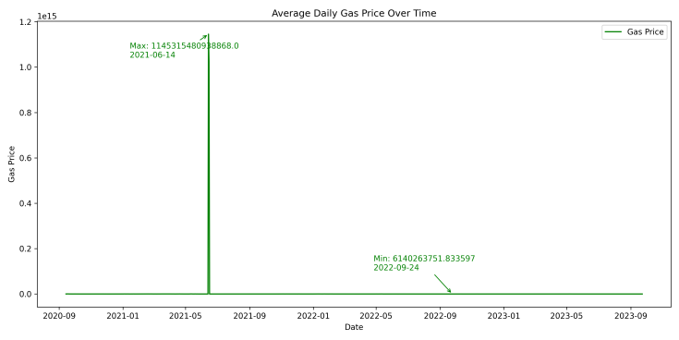
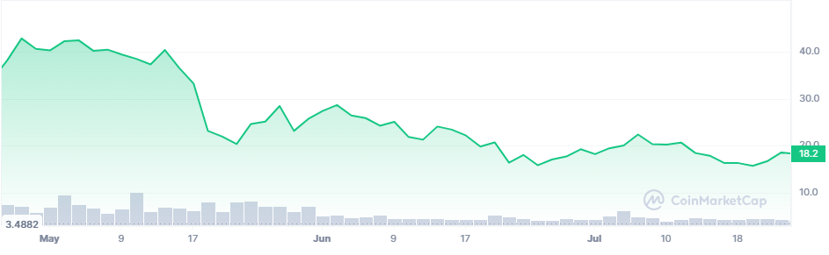
Gas Price Over Time
Huge gas spike on June 14th, 2021
Caused by price drop
Resulted in low volumes
2021

Slide 12

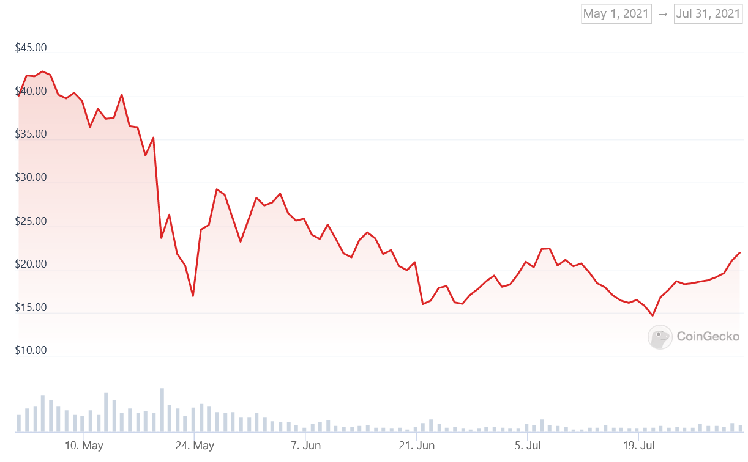
Temporal Analysis – Gas Over Time
Notes:
Next we’ll look at Average Daily Gas over time. We thought this would be interesting because high gas prices can deter users from participating in a transaction, while low gas prices can promote transaction activity, so we wanted to see how that looks over time.
The first thing you can probably notice the spike on June 14th, 2021, where gas reached an unusually high price. It might mean that there was extreme network congestion, a significant event in the community that occurred, or a hack.
One possible reason was there was a minor influx on that day in the graph (click) as seen here. On that same day, Ethereum experienced some price volatility and rose to a intraweek high but couldn’t sustain it.
This high spike could’ve discouraged users from transacting due to the costs, leading to a decrease in number of transactions.
It’s very interesting how this happened because we can see it is relatively stable for the rest of the time in these 3 years. It also raises concerns about data integrity, and if this spike represents actual conditions or error in recording or representation.

Slide 13
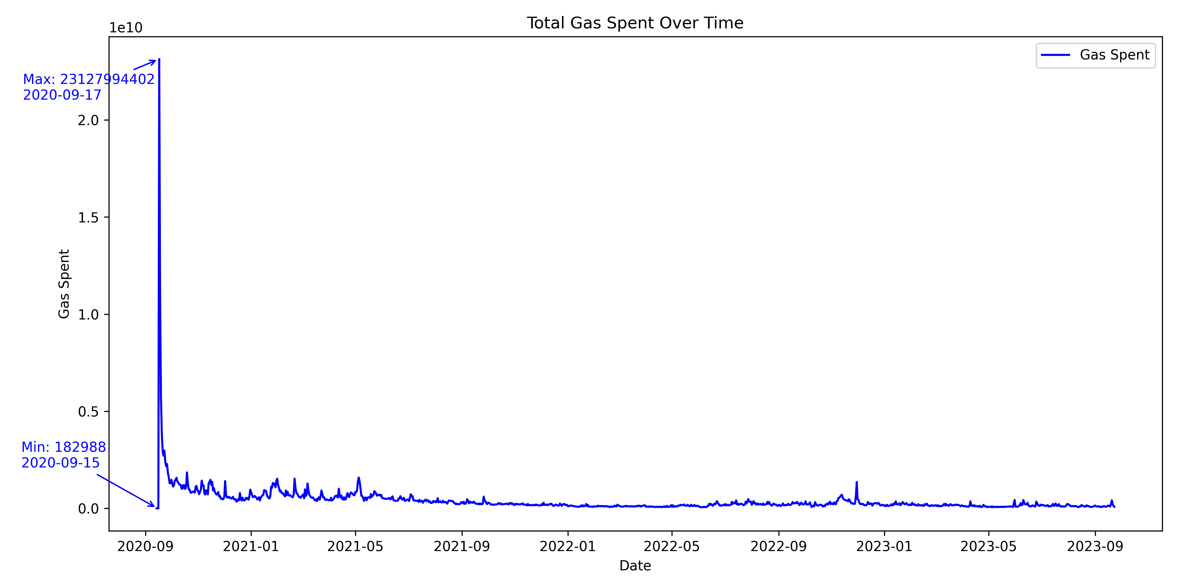
Temporal Analysis – Gas Spent Over Time
Notes:
Next we’ll look at gas spent over time.
We can see that the lowest Gas spent occurred on the 15th of September 2020. Meaning this was before the launch of the UNI token as we discussed. This makes sense because it means there would have been very little activity related to the token so it would have minimal transactional impact.
Then we see that the maximum occurrued on the 17th of September 2020, the day of the UNI token launch. This also makes sense because it shows the community engagement, and thus the network congestion due to high demand. It shows the eagerness of the community and investors leading to this surge.
Then we can see post launch that it begins to normalize or stabilize with fairly little fluctuations. We also see in 2021 there are these little fluctuations, and these could be due to the Uniswap V3 release.

Slide 14
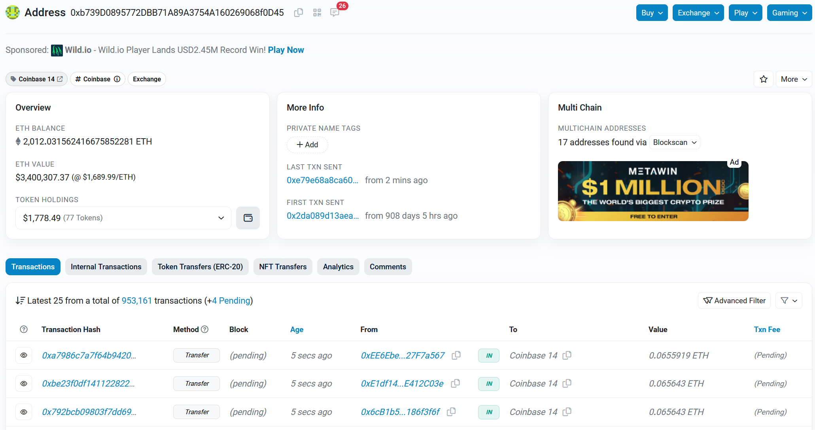
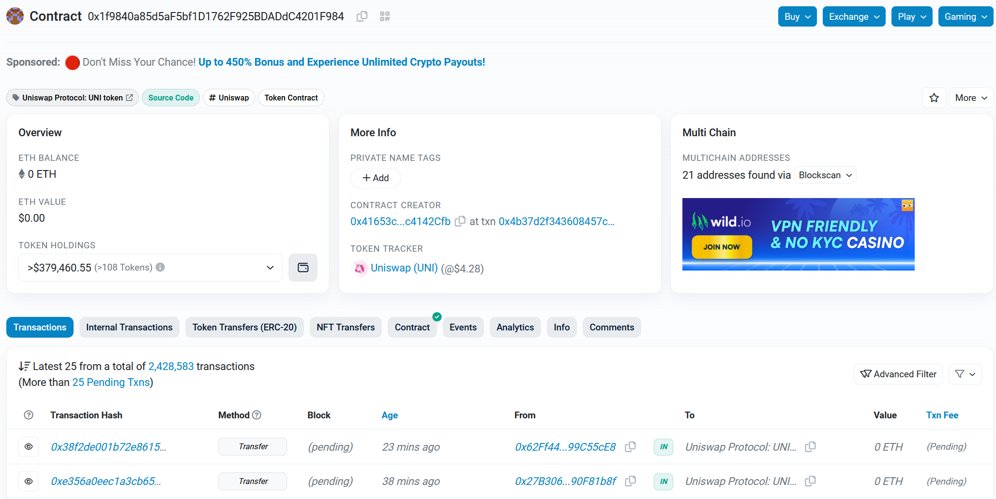
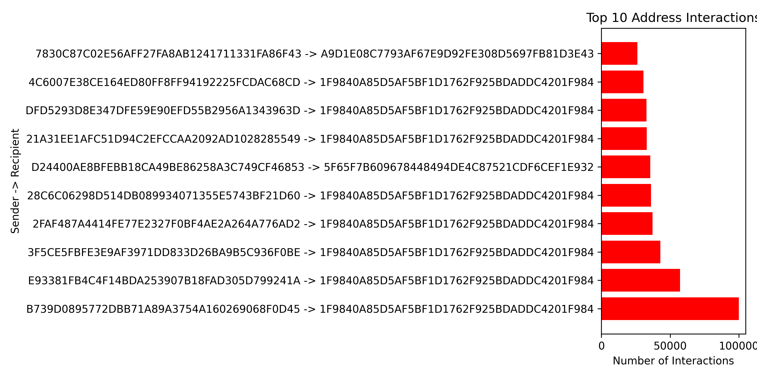
Top Interactions
Notes:
Next we’ll look at Top Interactions.
The first thing you may see is the high activity with the recipient address ending in 84. And this address is actually the official contract address for the UNI token (click). The reason people may be sending transactions to this address is to transfer tokens to another address, they might send a transaction to the contract using its transfer function with the recipients address and amount as parameters., Or maybe to allow a third party to spend tokens on their behalf, a user would call the approve function specifying the spenders address and allowance, and then use the transferfrom function. Or maybe to use the balanceOf function which can be called to check the balance of an address. Or might simply be by mistake
If we look deeper, we see that the sender at the number one spot is actually a coinbase affiliate address (click). This is most likely because its facilitating user trades, providing liquidity, or managing its own holdings of UNI tokens. For example if someone buys or sells UNI tokens on Coinbase, Coinbase may interact with the official UNI token address to update the users balance and execute the trade.

Slide 15
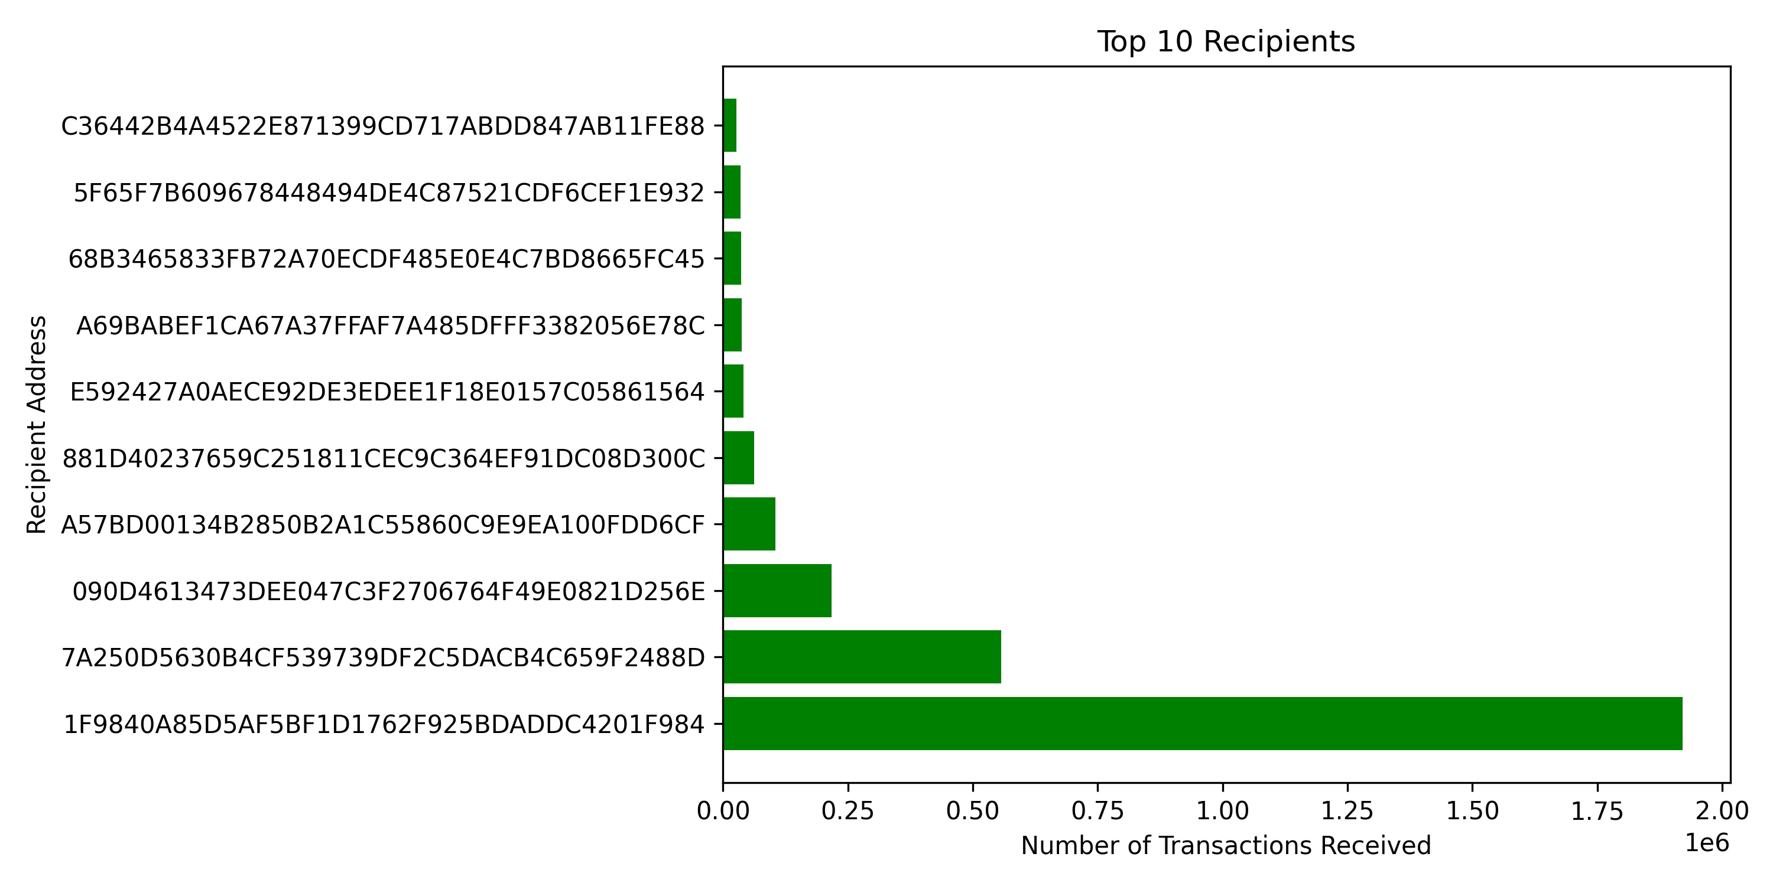
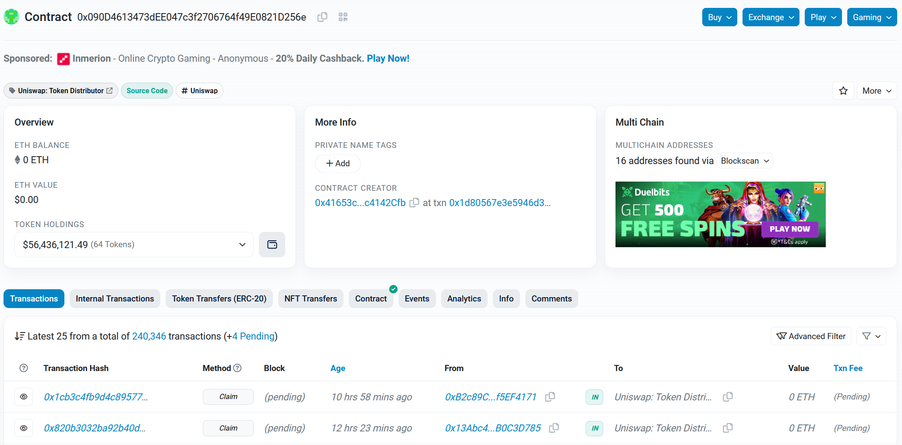
Top Recipients
Notes:
Next we’ll look at Top Recipients.
Once again we see that the #1 spot is the UNI token contract address, for the same reasons as the previous slide. When we look at the 2nd address with the highest number of transactions received, we actually see that it is also a Uniswap affiliated address. (click)
And if your also wondering, the 3rd spot and more on that list are also affiliated with Uniswap. So it’s safe to say that the common recipients are those affiliated with Uniswap.

Slide 16
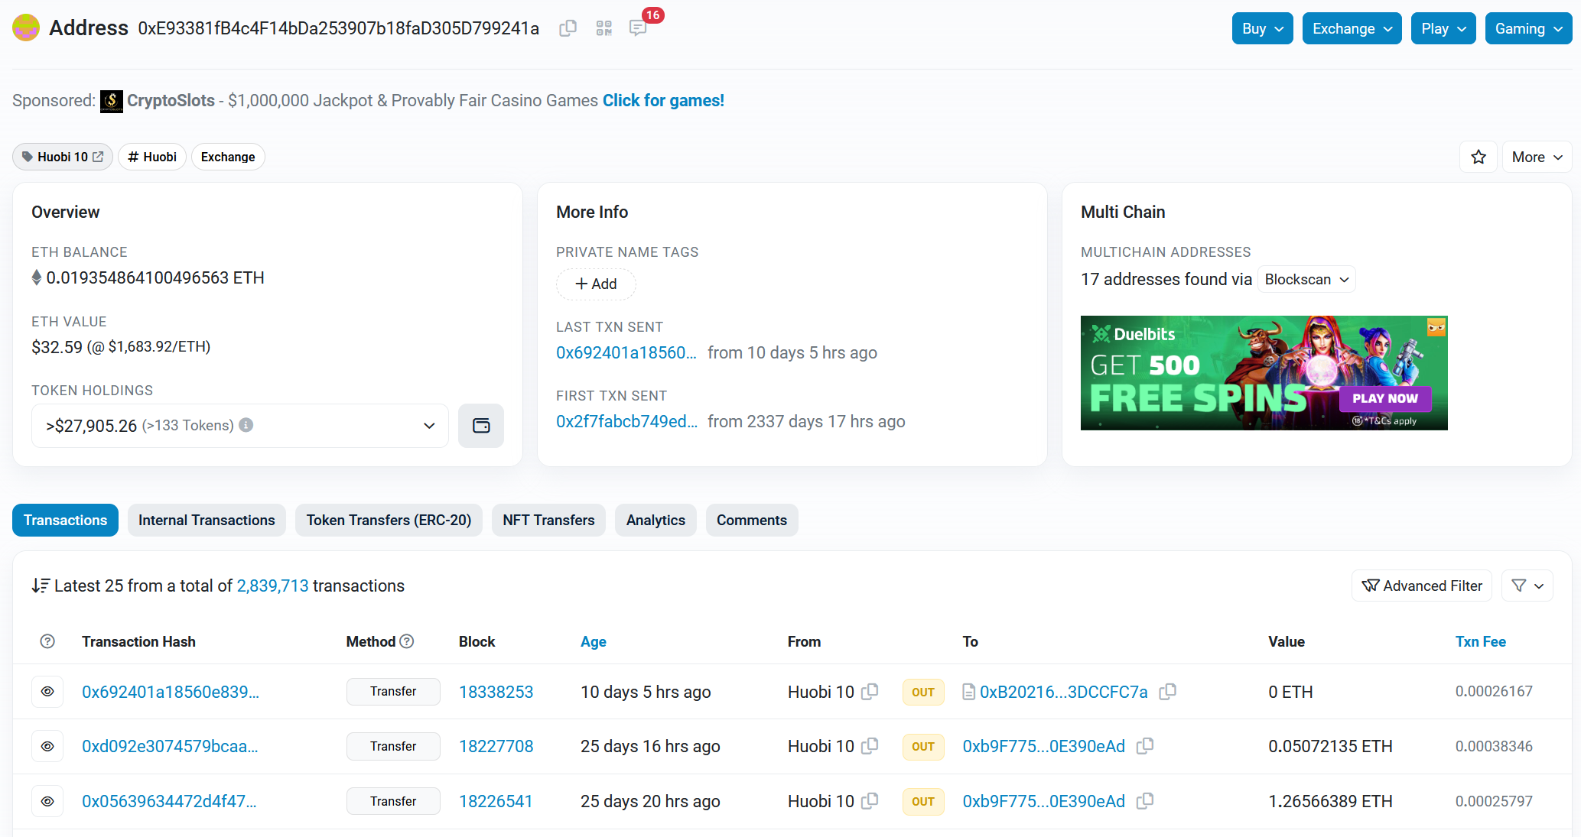
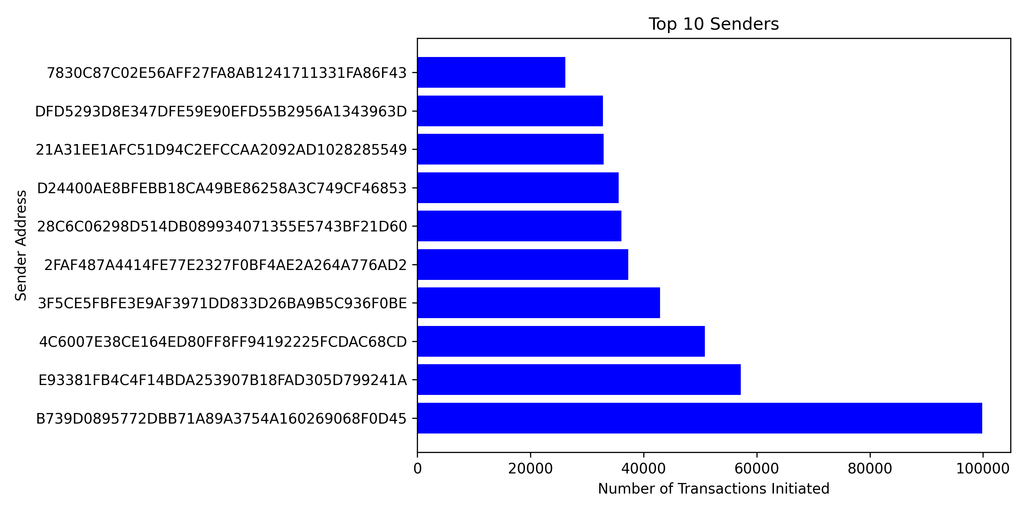
Top Senders
Notes:
Next we’ll look at Top Senders.
We already know from the previous slides that the #1 spot is affiliated with Coinbase, for the reasons mentioned before.
(click) When we look at the second spot, we see that it is affiliated with Huobi, which is also an exchange, and it makes sense why its there. So a lot of these addresses on this list are affiliated with exchanges, such as Binance, FTX, and more, for the same reasons mentioned in the previous slides.

Slide 17
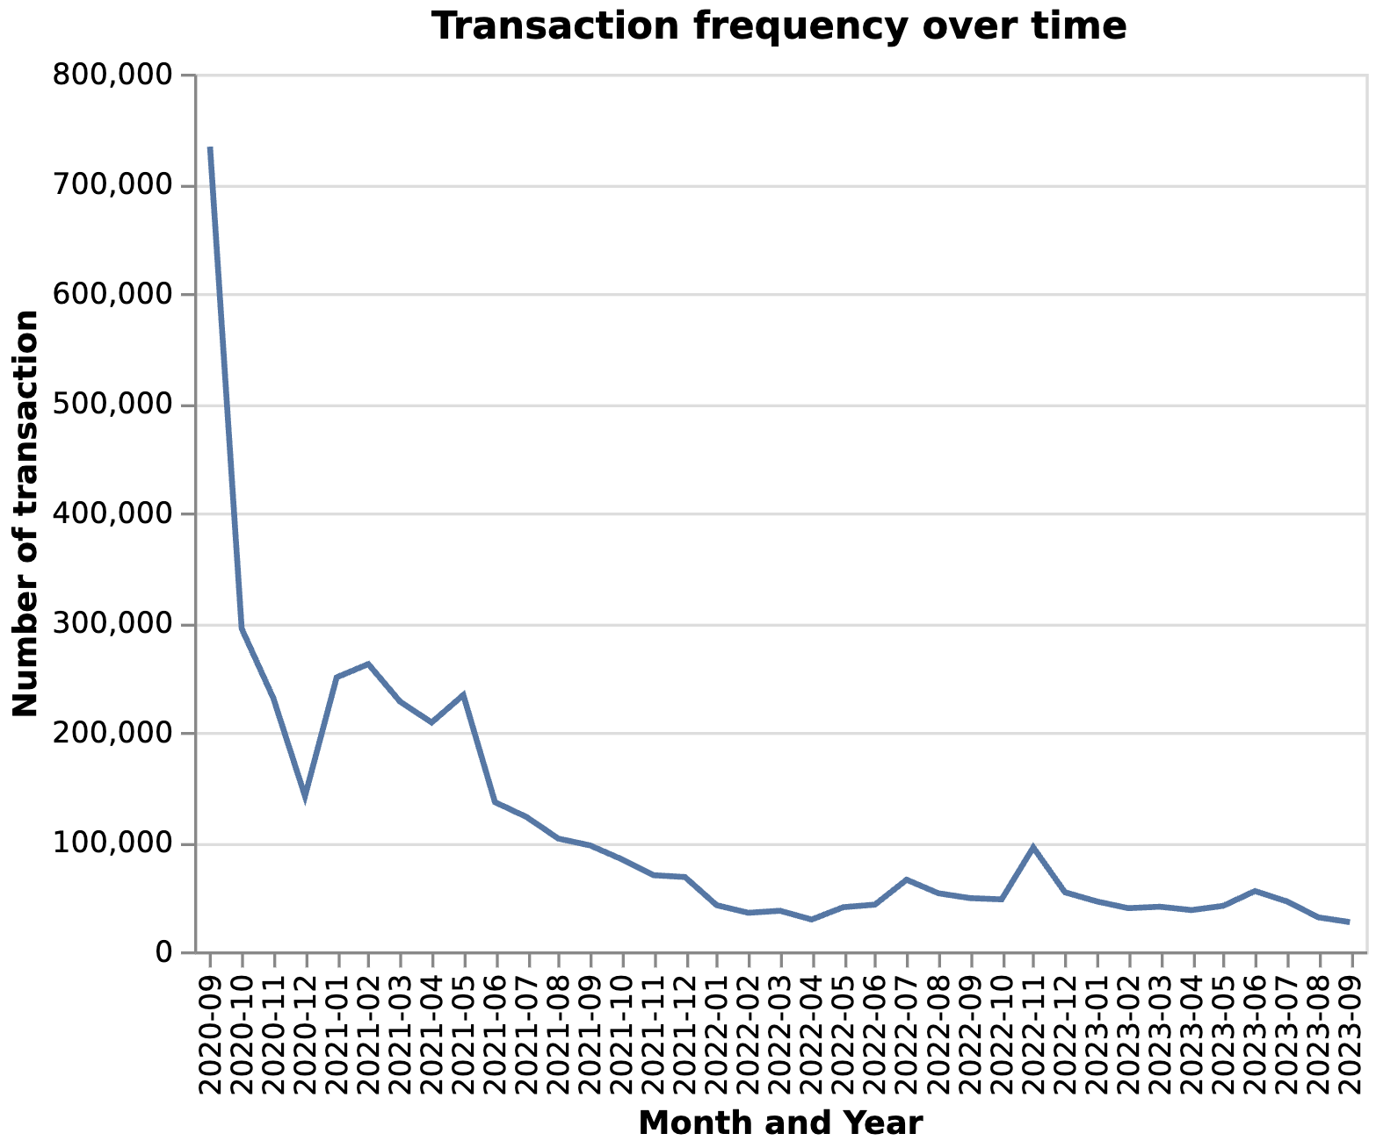
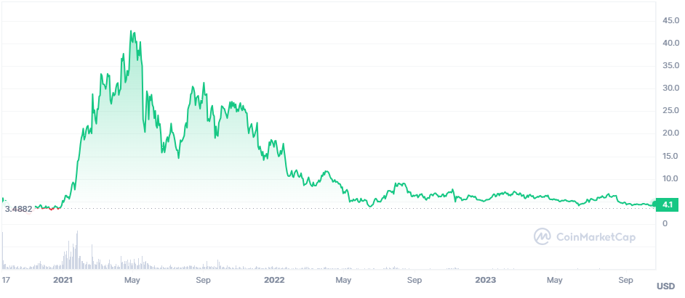
Transaction Frequency
Initial spike when original tokens were minted
High transactions when price was high
Small bump correlated to price drop (denoted by the star)

Slide 18
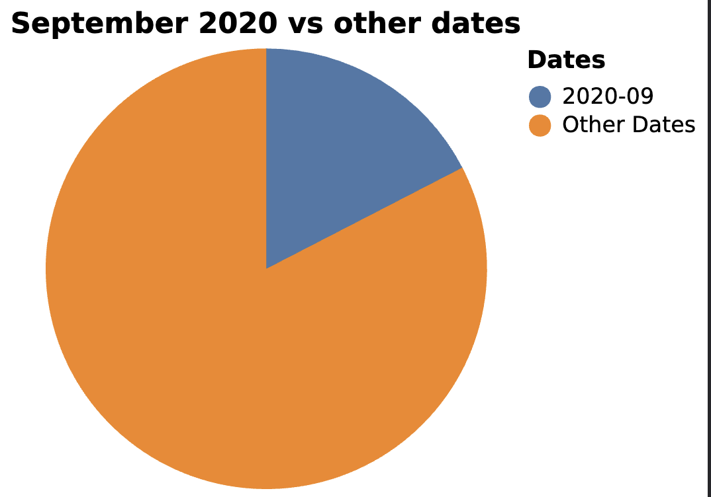
UNI Launch
September 16th, UNI token launch announced.
Over 297,000 logs the day after announcement accounting for over 7% of logs till date.
17.5% of logs accounted for in September 2020
Uniswap early adopter airdropped a minimum of 400 UNI Token
Airdrop to reward loyal users, build hype, gain attention and "decentralize" platform by distributing governance rights
Airdropped UNI to over 250k addresses
Only 7% of wallets that received airdrop are still holding UNI token

Slide 19
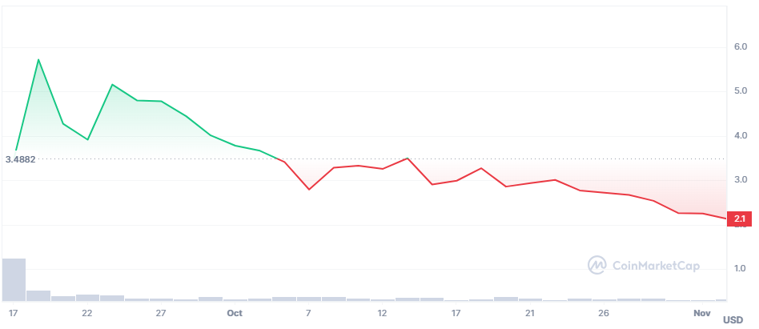
UNI Governance
Uniswap first governance vote failed despite 98% support
Fell 1% short of 40 million vote threshold needed for approval, received 39.6 million in favor votes
Proposal sought to reduce number of tokens needed to submit and pass proposal from 10 million UNI to 3 million UNI, and only require 30 million supporting votes
This is the October dip

Slide 20
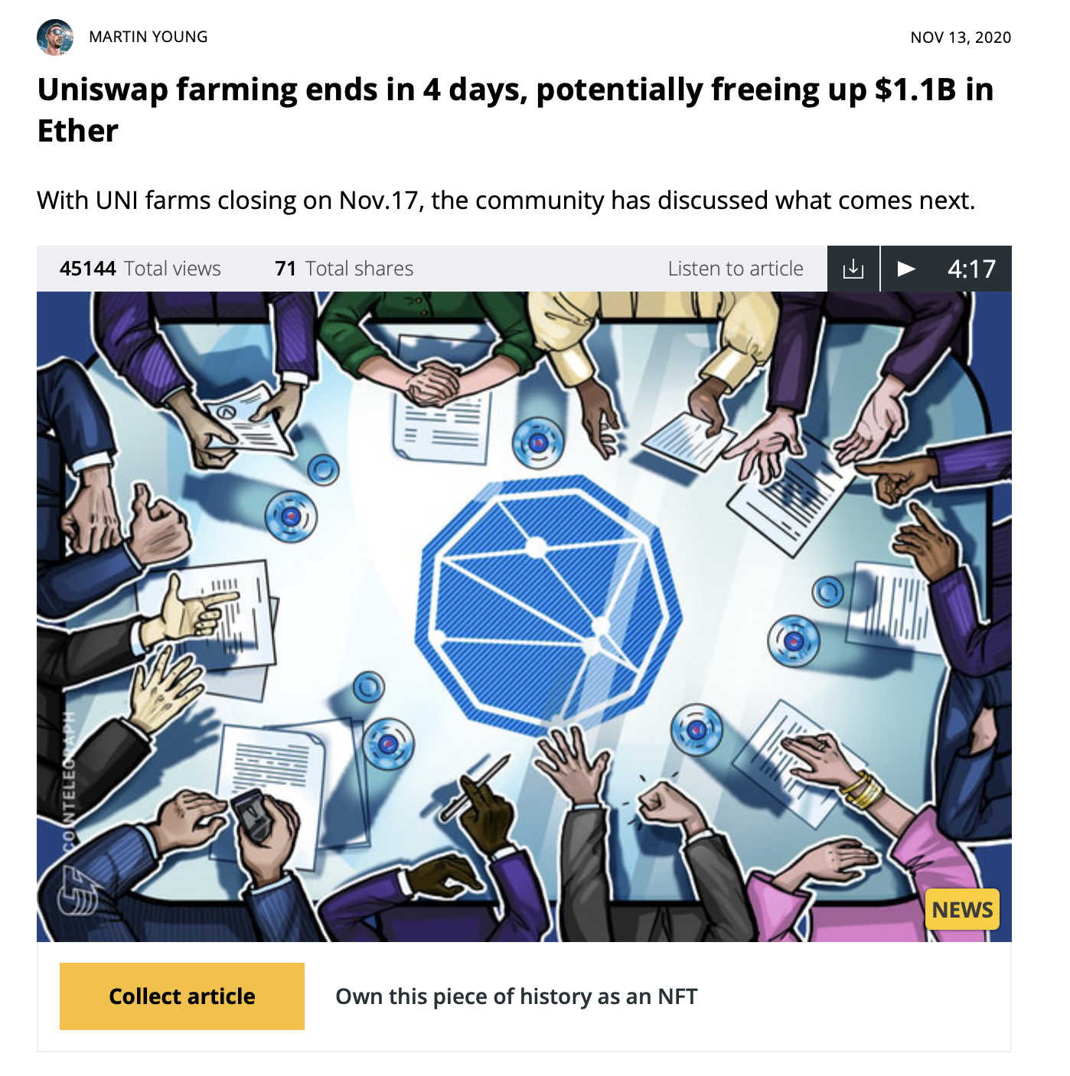
UNI Community
Community Call to discuss direction to take UNI Farming on Conclusion
No clear direction, no proposals submitted for extending UNI farming or launching new pools
Fear among UNI holders that token prices may dump in short term if users withdraw liquidity and sell off previously mined UNI

Slide 21
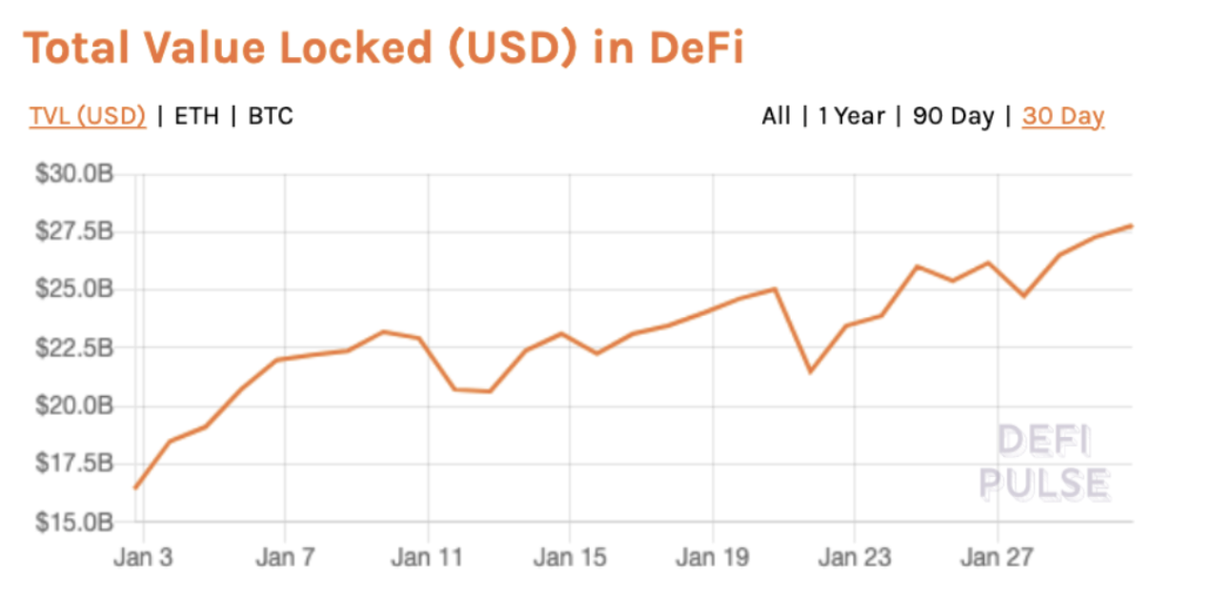
January 2021
Mostly, due to UNI soaring to a new all-time high at the time
Entire DeFi sector was in a strong uptrend.
Time of controversy for GameStop and AMC Stock made DeFi more attractive
Uniswap grants program unveiled January 20 for developers to receive funding for developing a project that adds value to the platform
Spike in January

Slide 22
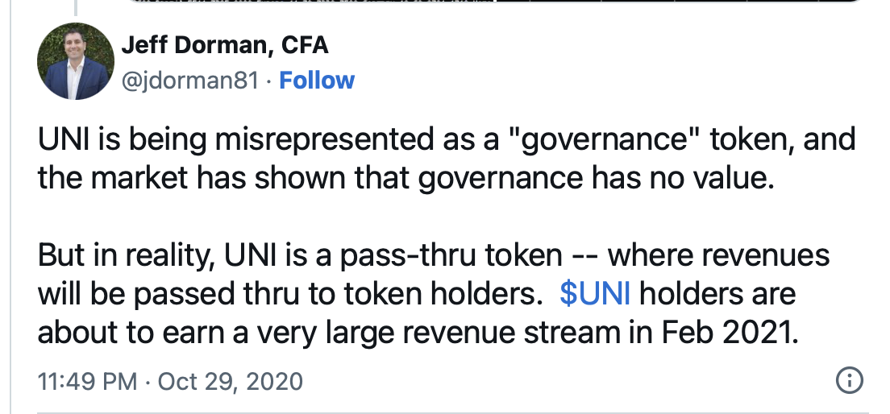
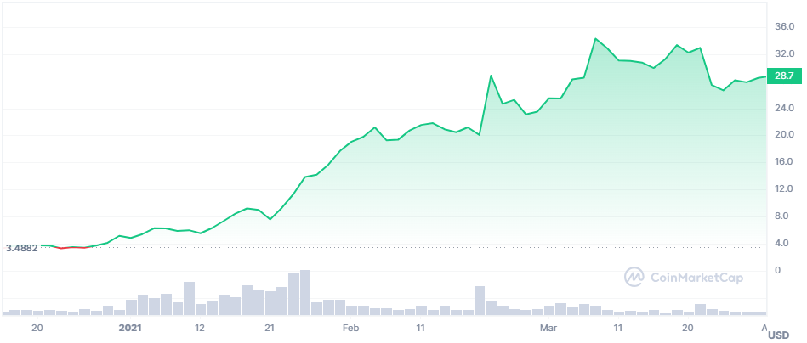
February 2021
Spike In February

Slide 23
Spike in May
March 2021, Price of UNI reached a new all-time high at $35.2 after announcement of Uniswap v3 launch
Uniswap V3 launch on May 5th, 2021, UNI token reached a high of $52.12

Slide 24
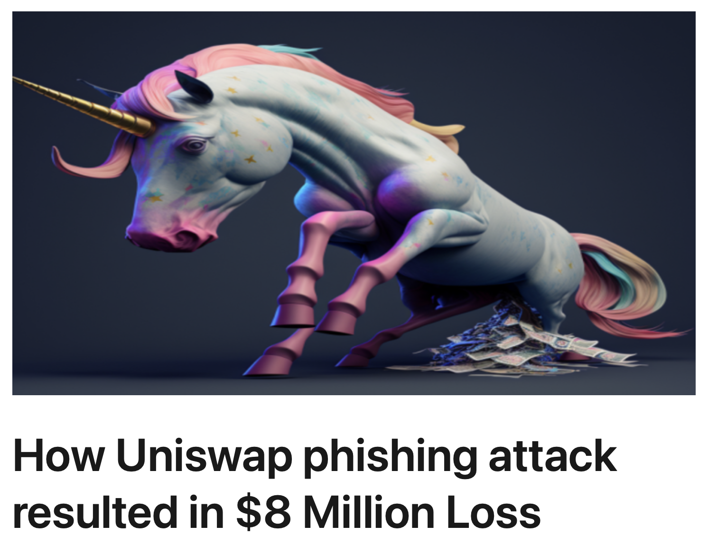
Little Spike In July 2022
July 11, 2022, about $8M worth of crypto assets were taken
Scam promised an airdrop of 400 UNI Tokens worth around $2,000
Connecting wallet to receive drop, user signed approval that allow scammers to steal funds held in Liquidity Pool tokens

Slide 25
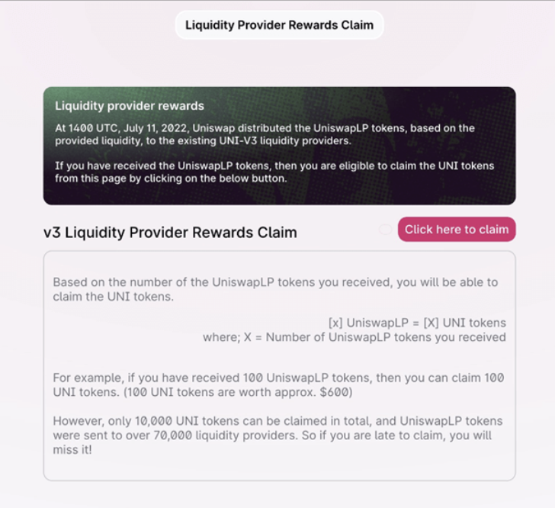
Phishing Scam
Phisher spent 8.5 ETH in TX fees to attack 74,000 Uniswap users with LP tokens in their wallets.
Users received phishing notification with false impression of a UNI airdrop.
Trap was a masked 'setApprovalForAll' function that could assign or revoke full approval rights of the wallet to the caller and attacker withdrew all Uniswap v3 LP tokens the user held
Notification redirected recipients to scam website with impersonated uniswap.org.
Attackers fed contract function with false data leading victims to believe Uniswap as the sender.

Slide 26
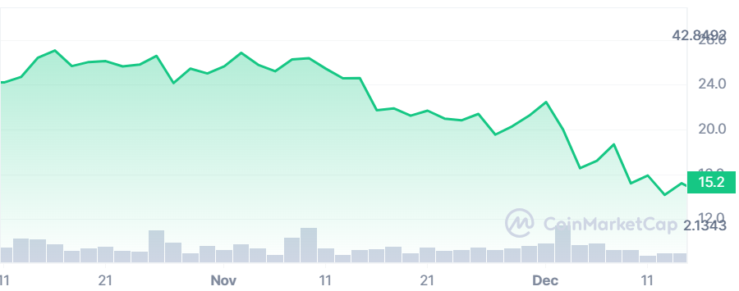
November 2022
Uniswap did a $165M Series B in October 2022
Launched a NFT in November including a $5M airdrop to users of Genie, a company Uniswap acquired in June 2022

Slide 27
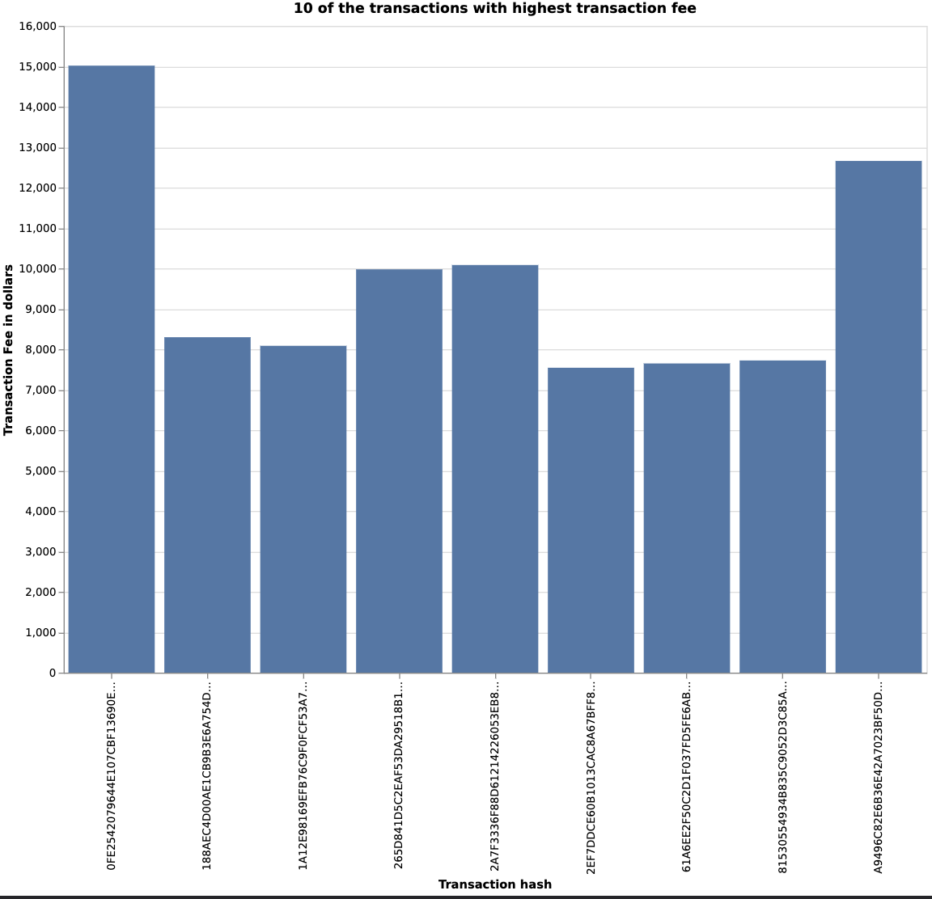
Tx Hashes with Highest Frequency

Slide 28
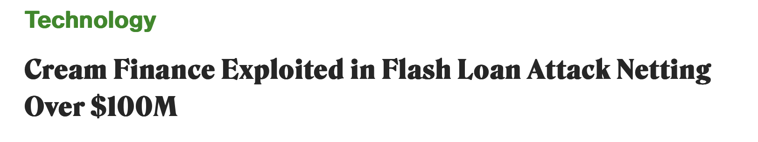
Cream Finance Attack
Top Transaction hash with highest Transaction Fee was a fraudulent scheme:
0FE2542079644E107CBF13690EB9C2C65963CCB79089FF96BFAF8DCED2331C92
Attack occurred in October of 2021
Cream calculated the value of yUSDVault tokens based on total supply. By manipulating the supply, the attackers were able to fool the protocol into a false valuation

Slide 29
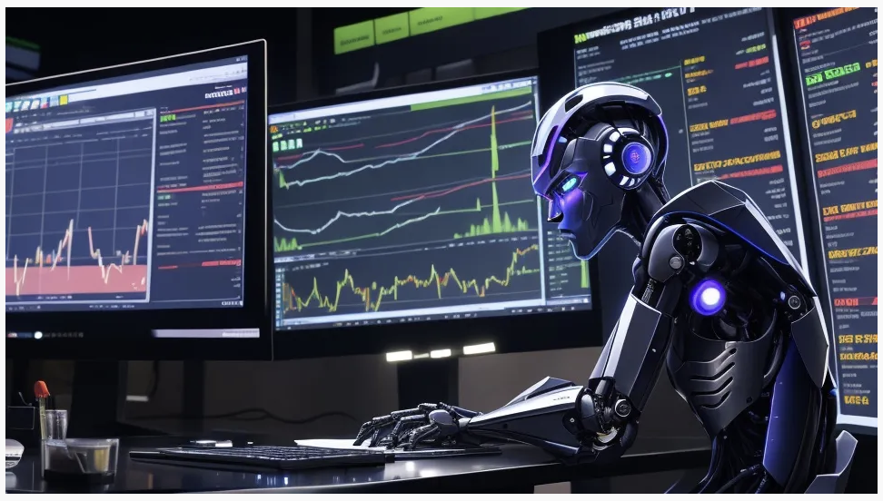
MEV Bots
A sizeable percentage of high Transaction fee hashes are executed with MEV Bots
Can detect and exploit profitable opportunities on ETH blockchain by manipulating the order of transactions in a block
Designed to perform strategies such as arbitrage, frontrunning, sandwiching, and flash loans.
Benefits – Income, efficiency, enhancing innovation
Risks – Reducing Fairness, increasing volatility, and threatening security

Slide 30
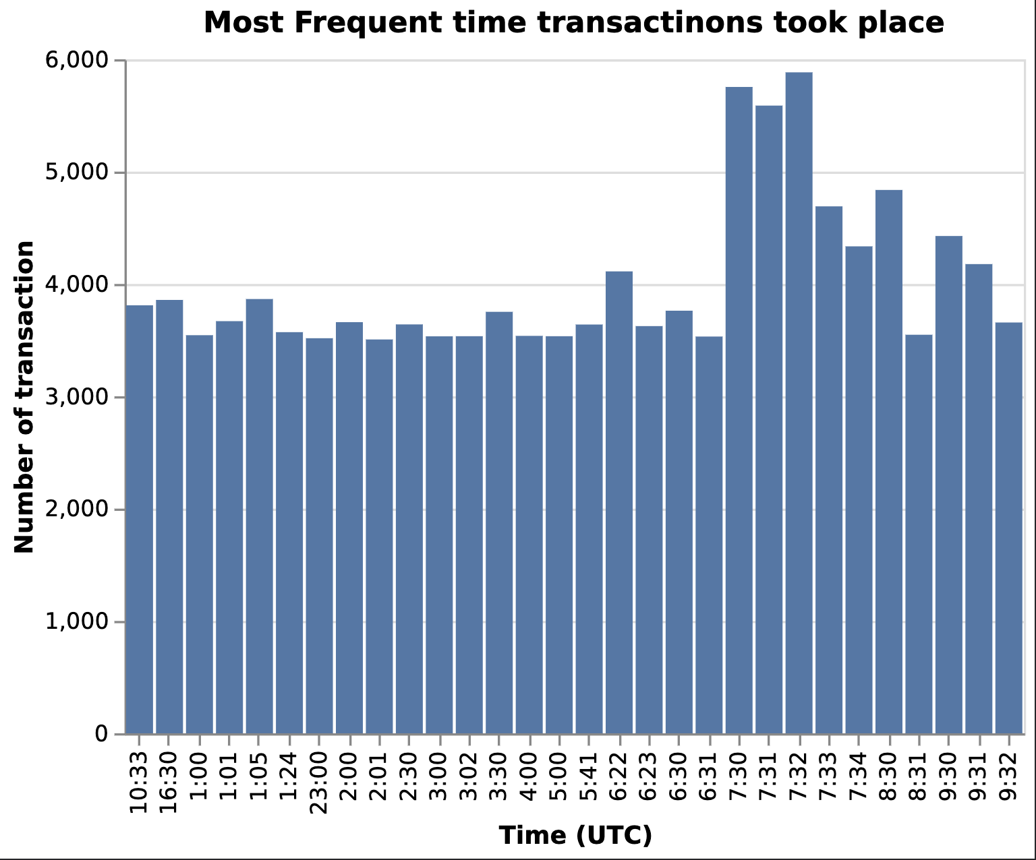
Transaction times
Highest volume observed on 7:30, 7:31, and 7:32
1:30am Calgary time
The UK stock market opens at 8am
Chinese stock market closes at 7am
Majority of numbers hover around “X:30” or “X:00” which could be pre-set transfer times

Slide 31
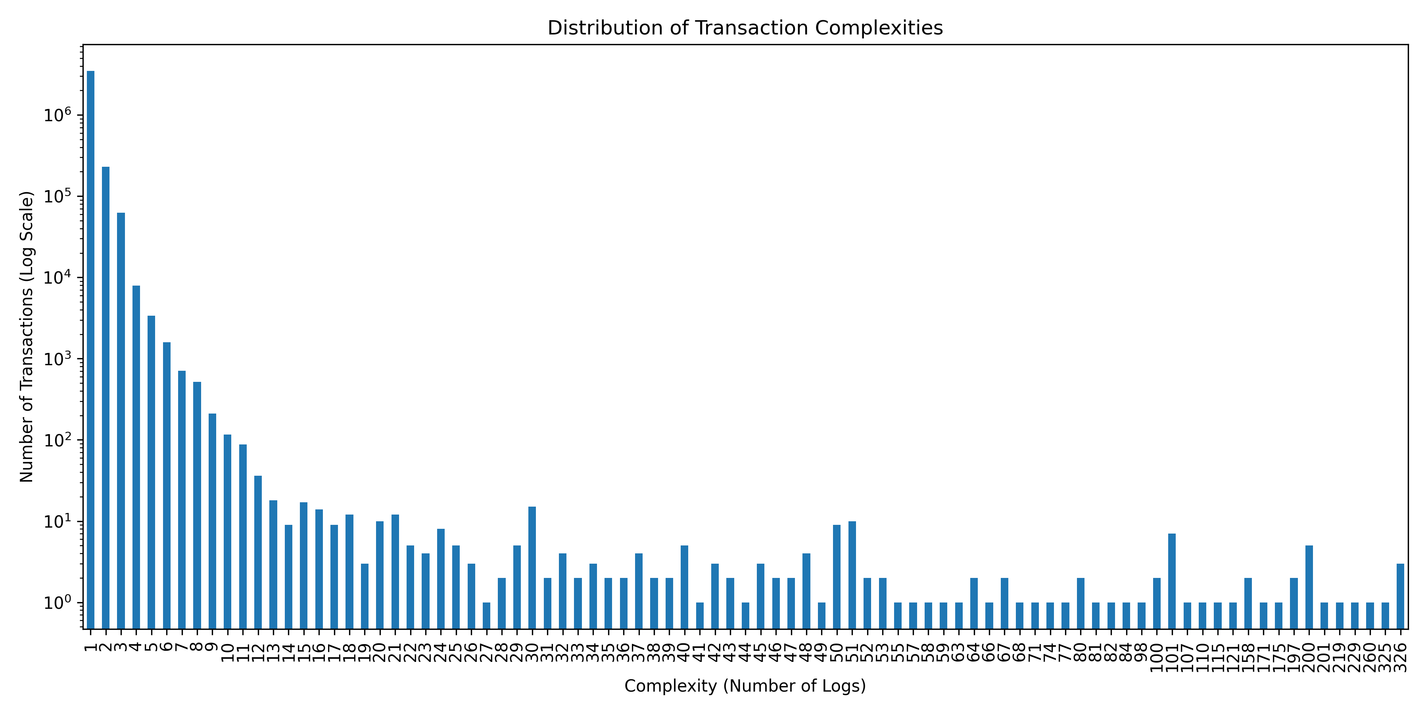
Distribution of Transaction Complexities
Notes:
Here is a distribution of Transaction Complexities. We thought it would be interesting to see how many logs were emitted for each transaction so we graphed them.
As we can see, the majority of transactions in our data had mainly low or low to medium complexities. Most transactions only had 1 log emitted, while there were some transactions with as high as 326.
We thought this would be interesting because logs provide a record of events, and the more logs associated to a transaction, the more complex it would be. For example, if a transaction has many logs, it can indicate that the transaction interacted with multiple contracts on the blockchain. A simple transfer of tokens might result in a fewer amount of logs, while a more complex operation like swapping tokens that involve liquidity pools, fee’s, and more might generate more logs.
It’s also important because the more complex a transaction is, the more it costs computationally on the network, and thus it will generally have more fees. Complex transactions can also take longer to process.
We can see that most transactions with the UNI token are simple transfers, but there are also highly complex transfers occurring as well. So this tells us a lot about the UNI token user base.

Slide 32
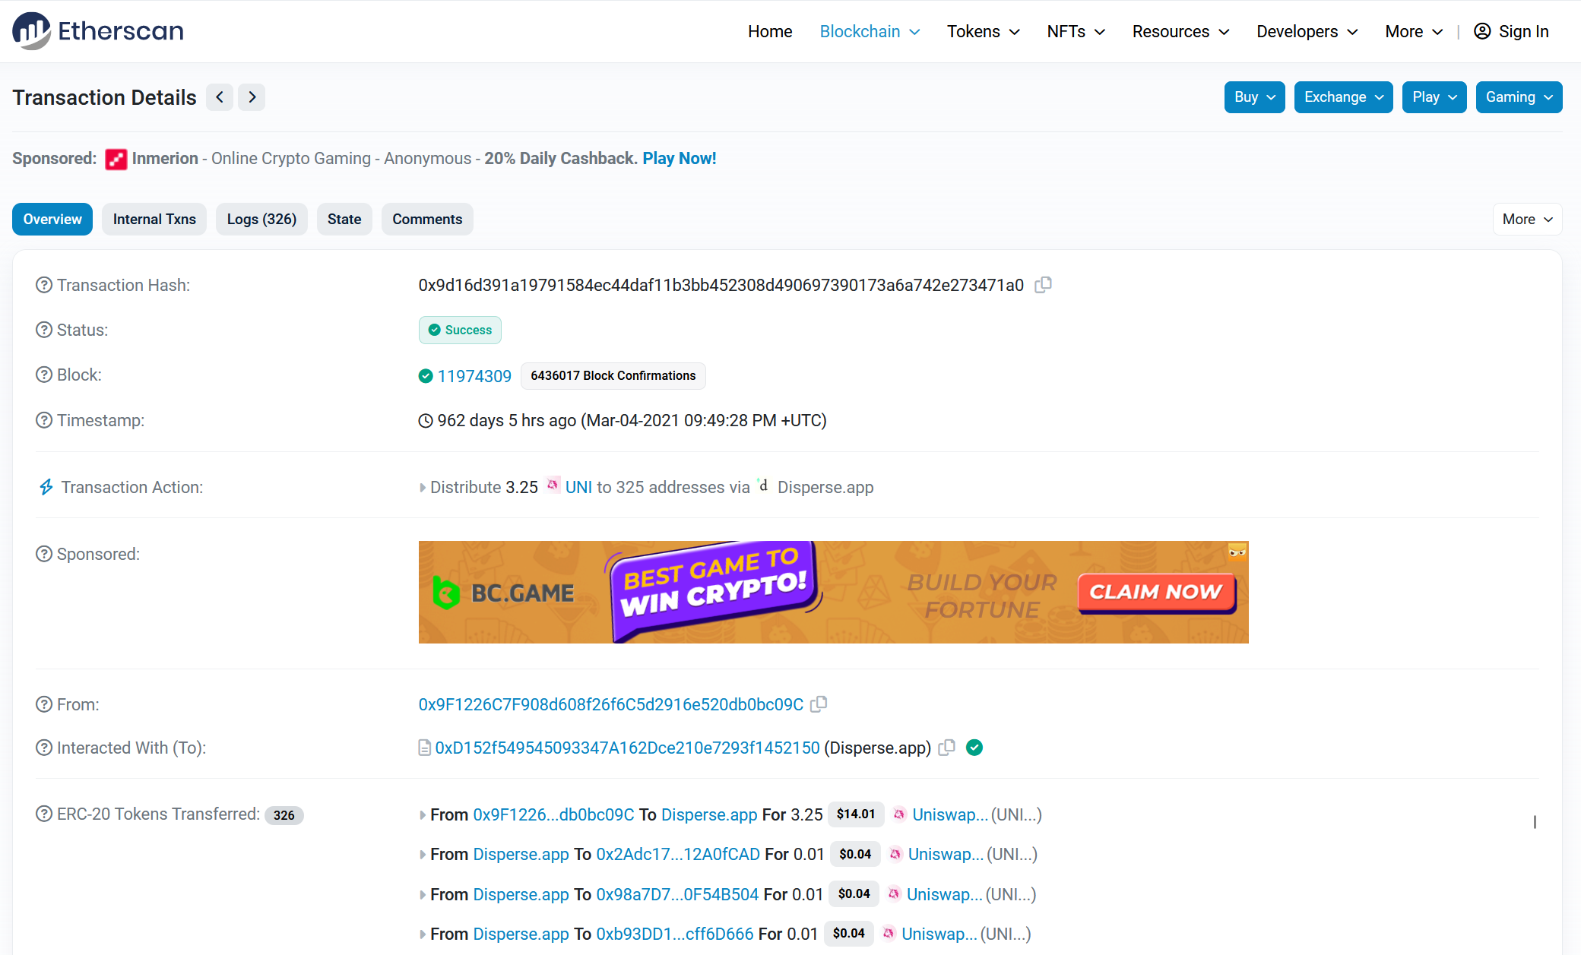
Distribution of Transaction Complexities
Notes:
For example, when we go to one of the transactions with the maximum we found of 326 logs. We can see that for whatever reason, this transaction was meant to distribute 3.25 UNI tokens to 325 addresses via Disperse, which is an application that is meant to distribute ether or tokens to multiple addresses. What’s also interesting is actually all of the transactions with the maximum complexity we found were via the Disperse App.

Slide 33
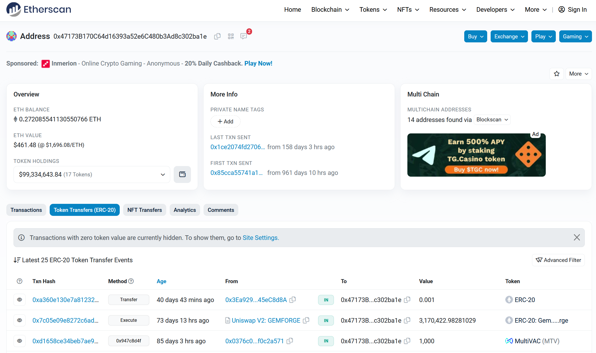
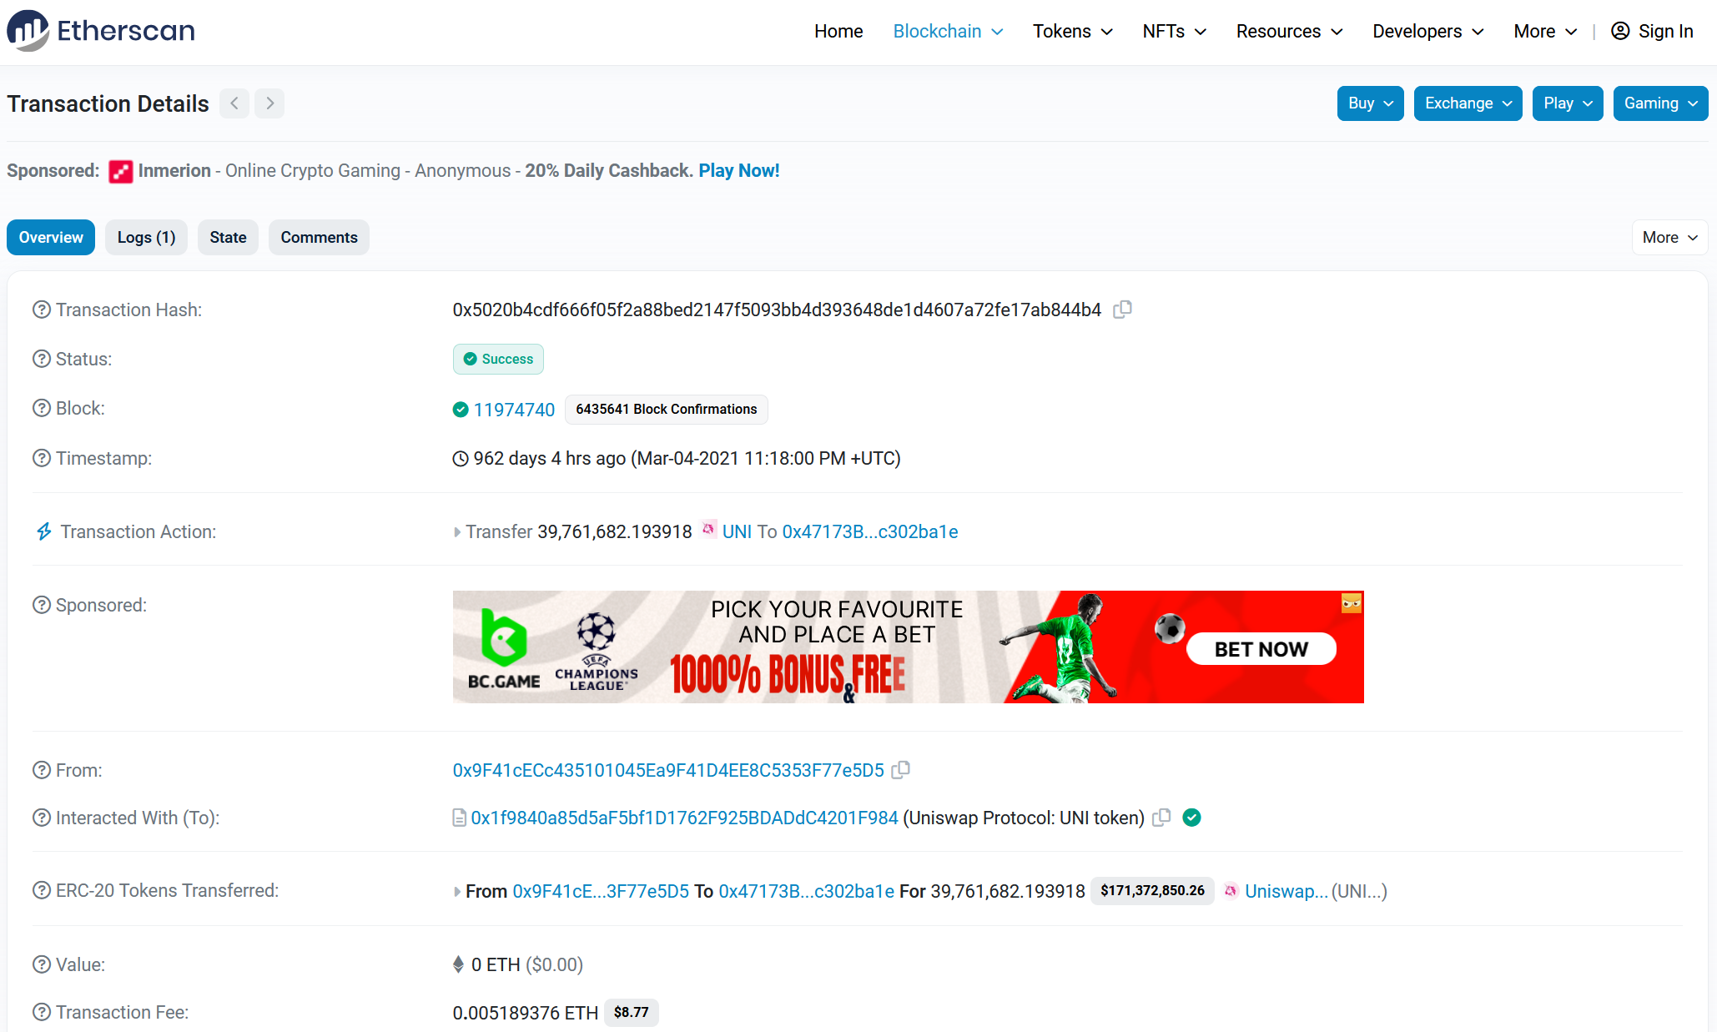
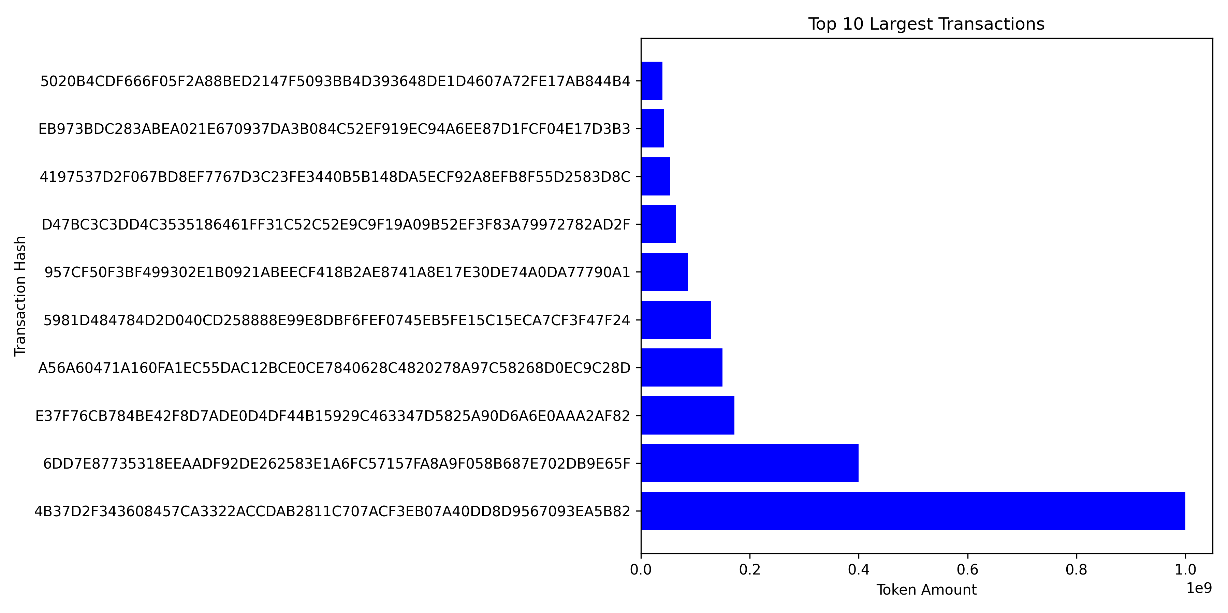
Largest Transactions
Notes:
Next we started looking for the top 10 largest transactions via Token Amount.
And to put this graph into perspective, the #10 on this list transferred about 40 million UNI tokens, which is valued today at $171 million. (click)
When we analyze who it’s going to and who it’s from, it’s safe to say that whoever did this transaction was probably looking to just migrate to a new address. What’s also interesting is that the address that it went to (click) actually has tokens valued at $99 million dollars, and $99 million of those are from the UNI token. So that’s pretty interesting
Now I know you guys are probably wondering, what about the #1 spot??

Slide 34
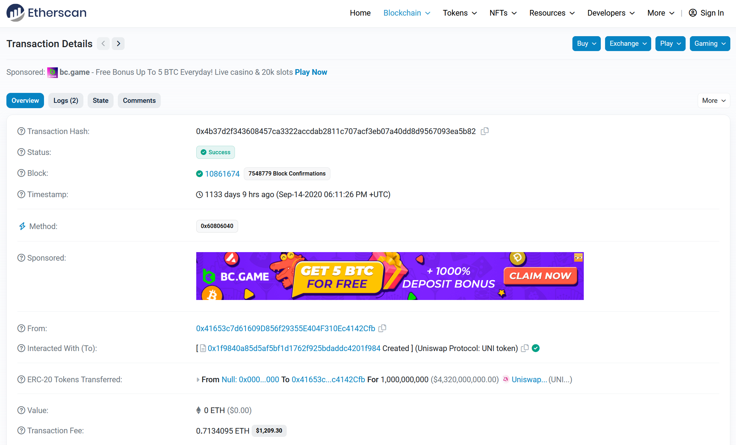
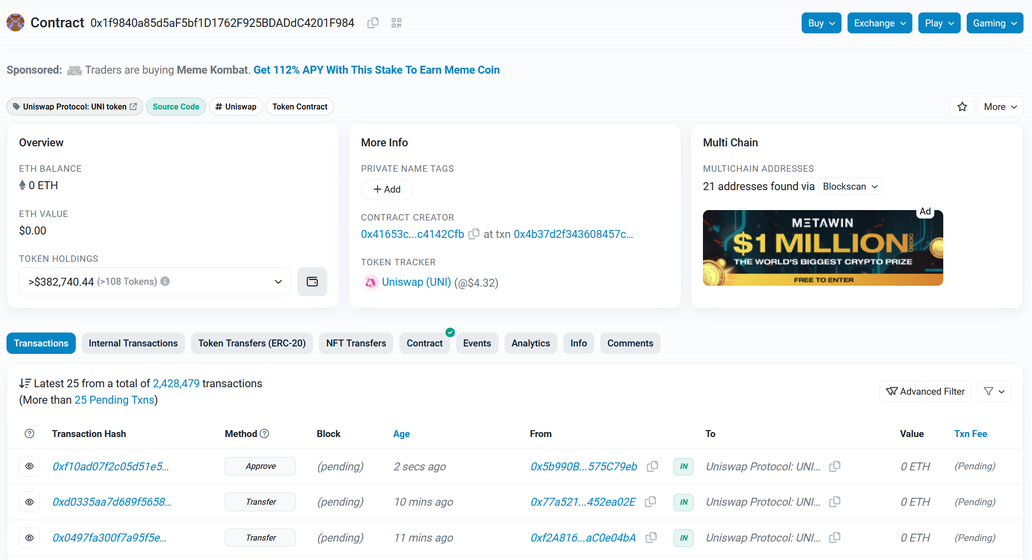
Notes:
The #1 spot is actually interesting. It transferred 1 billion tokens valued at $4.3 billion dollars today.
As you may have noticed, it says it comes from a Null address, and the recipient address is actually (click) the official UNISWAP protocol address. This address contains the code that defines how the token behaves like transferring tokens, minting tokens, etc.
And if we look closer into the date that this transaction occurred, which was September 14 of 2022, we see that this was actually the mint that occurred for the distribution of UNI tokens that happened September 17 2022. And we also know this due to the fact that it came from a null address.

Slide 35
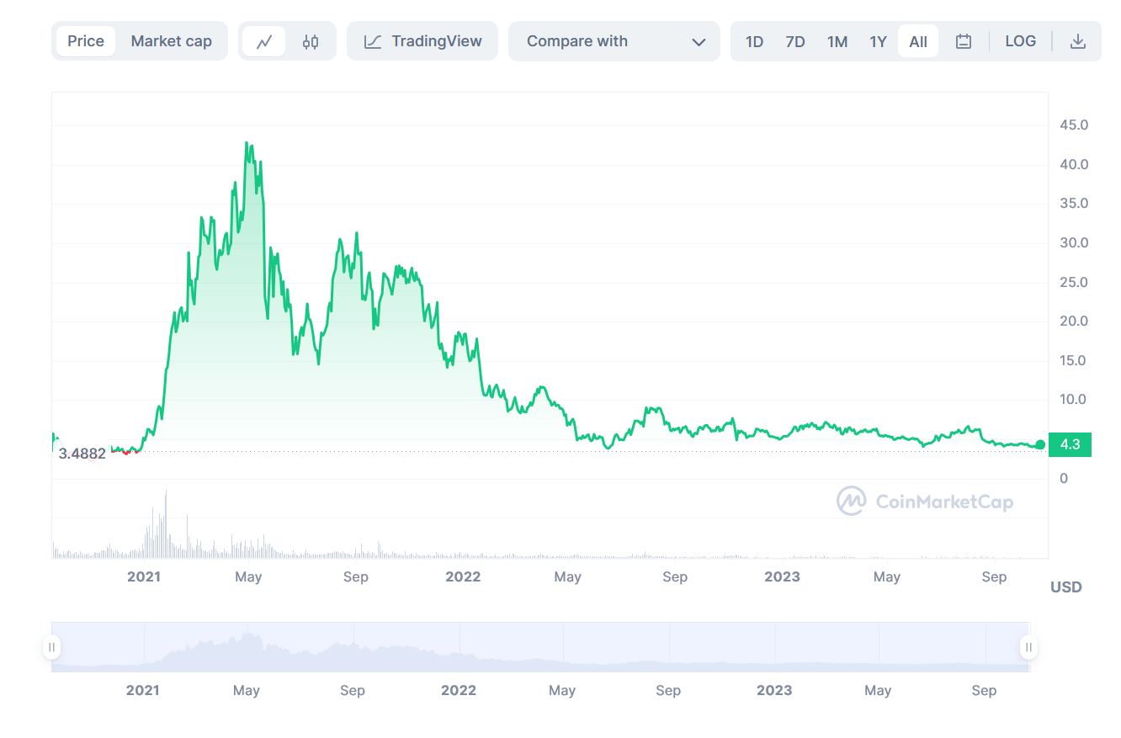
Notes:
And if we look closer into the date that this transaction occurred, which was September 14 of 2022, we see that this was actually the mint that occurred for the distribution of UNI tokens that happened September 17 2022. And we also know this due to the fact that it came from a null address.
As we mentioned in the introductory slides, there still a total supply of 1 billion UNI tokens to this day.

Slide 36
THANK YOU!
Questions?

